Slide 1
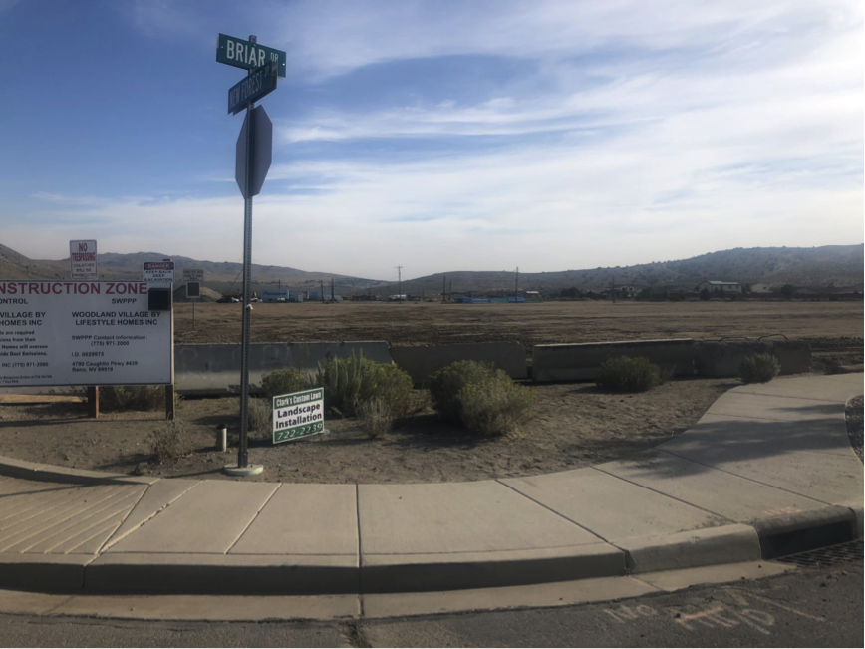
WSUP19-0017
Cold Springs Elementary School Grading
Washoe County Board of Adjustment
October 3, 2019

Slide 2
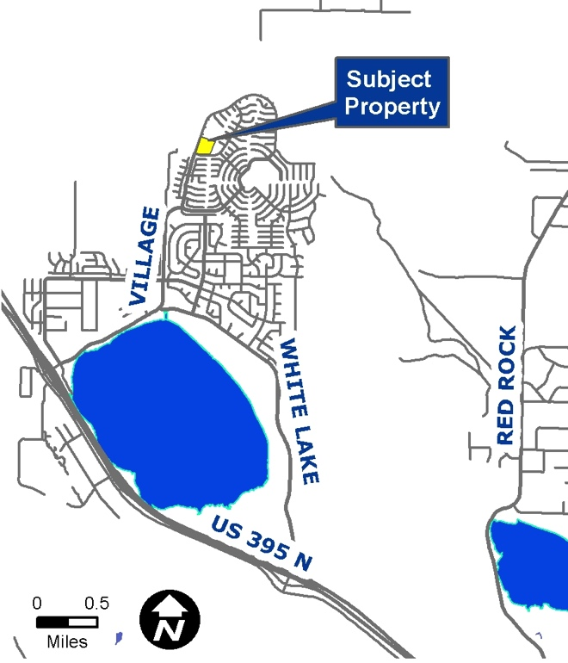
Location
Northeast of the intersection of New Forest Dr. and Briar Dr. in Cold Springs
7 alternative sites were considered

Slide 3
Overview
Grading, construction and landscaping for a 745-student elementary school
Medium Density Suburban (MDS) regulatory zone
Public schools are allowed by right in this zone
Grading triggers the major grading thresholds, requiring a special use permit

Slide 4
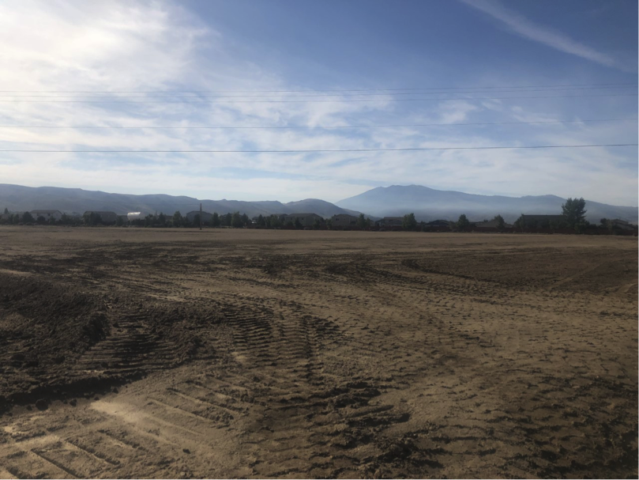
Overview
10.07 acres
±1,617 cubic yards excavation
±93 cubic yards of imported fill material
Mass graded as part of the approved tentative map for the Woodland Village development

Slide 5
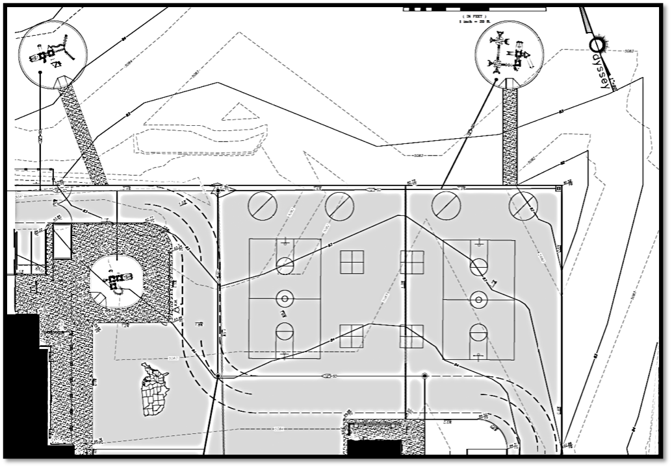
Playground Grading Plan

Slide 6
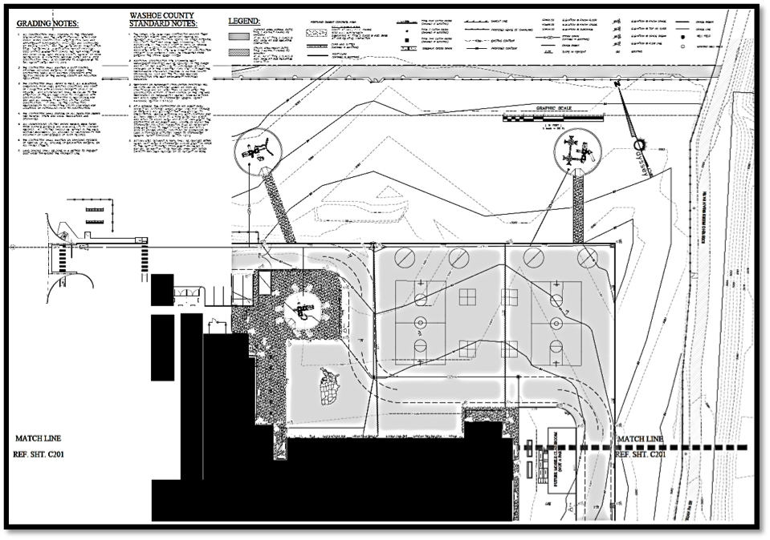
Overall Site Plan

Slide 7
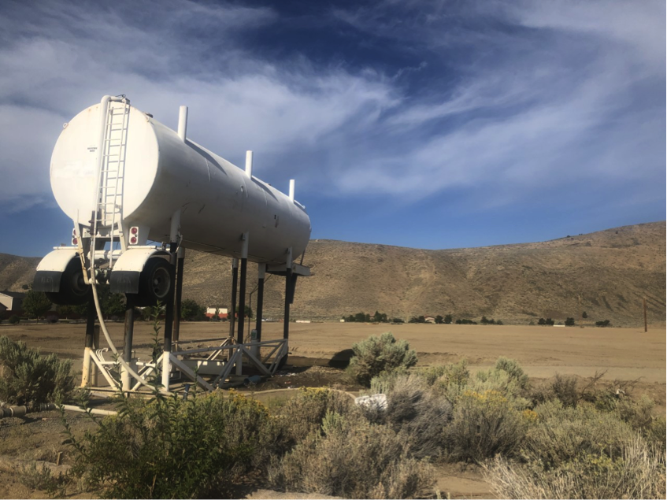
Best Management Practices
Dust control program
Watering open areas
Conforming to Washoe County air pollution regulations
Temporary stabilization of all disturbed areas
After 30 days, treating disturbed areas with a dust palliative

Slide 8
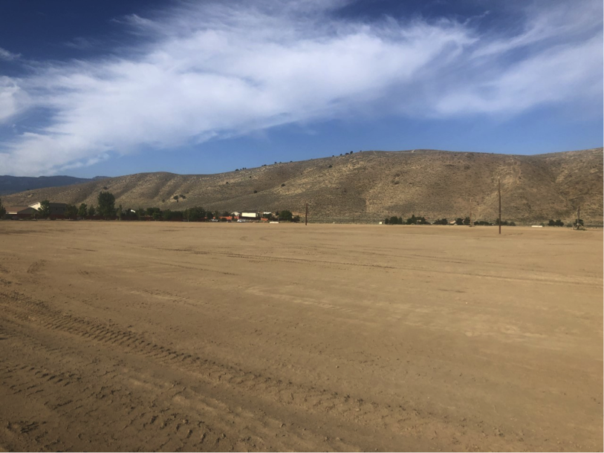
Looking Southwest

Slide 9
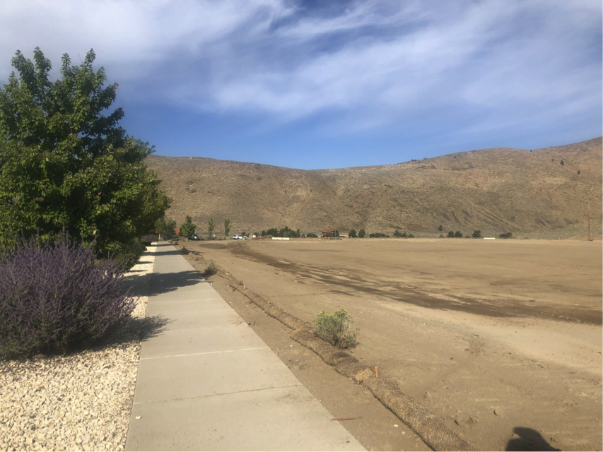
Looking South Along Eastern Border

Slide 10
Public Notice & CAB
Notice sent to 92 affected property owners
North Valleys CAB reviewed the application on September 9, 2019 and voted unanimously in support of approval

Slide 11
Reviewing Agencies
Washoe County Community Service
Washoe County Health District
Truckee Meadows Fire Protection District
Washoe County School District
Washoe County Sheriff’s Office
Washoe-Storey Conservation District
Regional Transportation Commission
Nevada Department of Transportation
Nevada Department of Forestry
Nevada Department of Environmental Protection

Slide 12
Special Use Permit Findings
Consistency
Improvements
Site Suitability
Issuance Not Detrimental
Effect on a Military Installation

Slide 13
Possible Motion
I move that, after giving reasoned consideration to the information contained in the staff report and information received during the public hearing, the Washoe County Board of Adjustment approve with conditions Special Use Permit Case Number WSUP19-0017 for the Washoe County School District, having made all five findings in accordance with Washoe County Code Section 110.810.30

